Slide 1
College Notes Gallery
Shri Shankaracharya Institute of Professional Management & Technology, Raipur
Major Project Phase-I Report on
CSE 7th Semester
Department of Computer Science and Engineering,
Batch 2019-2023
Session Jul – Dec 2022
Presentation Date: 24th January 2023
Project Guide
Mr. Dheeraj Kumar Ghaghre
(Assistant Professor, C.S.E. Department)
Project Group Members:
Mohan Sahu- 303302219062
Abdus Sami Khan- 303302219002

Slide 2
Introduction about project
In the existing system all the activities are done manually. Mostly the notes are circulated on Whatsapp or any kind so it gets very difficult to manage the important notes at the time of need. It is very time consuming. It manage the college information , student information. In our proposed system “College Notes Gallery” the data will be stored in the college server. To store the data SQL server will be used. The Admin, Faculty or the student should be a register user. College staff can upload attendance, college notifications, online interface through admin. The courses and subject management module will do the assigning of subjects for every course that the college offers. The admin of the college can have and monitor the information of the student. The system offers reliability, security, time savings and easy control. This will brings more perfection to the work.

Slide 3
Application Area
Why did we opt to work on this project?
There are many students who face problem in studying at the exam time because either they don’t have the notes provided by teachers or they must have not been in the college. This System will provide a platform to easily access the notes. The design and implementation of the system is to provide service in institute and colleges. The system is to provide comprehensive student information system and user interface is to replace the current paper records. College Staff uploads attendance, results, share subject notes. Achieving this objective is difficult using a manual system as the information are scattered, can be redundant and collecting relevant information may be very time consuming. Using Mayer’s Diff algorithm admin can see the similarity while uploading the notes.

Slide 4
Applications and Benefits of this project-
Students will stay updated with notes.
Notes will be in form of images, pdf files, text files, videos.
The management system will be very simple and it will be also simplify and speed up the result preparation and management process.
End Users of this project-
1.Students
2. Admin(Teachers)

Slide 5
Work Flow Diagram
Student/Teacher
Visit Website
Register/login
and Admin will acknowledge
Notes access/ download
Admin Will login the website
Upload the notes and check the similarity using Diff Algorithm
Admin will click the submit button to upload the notes
Admin will click the submit button to upload the notes
Admin will click the submit button to upload the notes
Notes get uploaded

Slide 6

UseCase Diagram
Visit Website
Register
Login
Approve Notes
Student
Admin
Upload Notes
Log Out

Slide 7
Result
It is the home page of the proposed system which contains the uploaded notes of all the subjects of the 3rd semester of the college.
Each subject are having different notes of their units or chapters uploaded by the admin.

Slide 8
This is the the notes of unit 5 which contains different sections including notes, question paper, books in the form of PDF, text, image format uploaded by the admin.

Slide 9
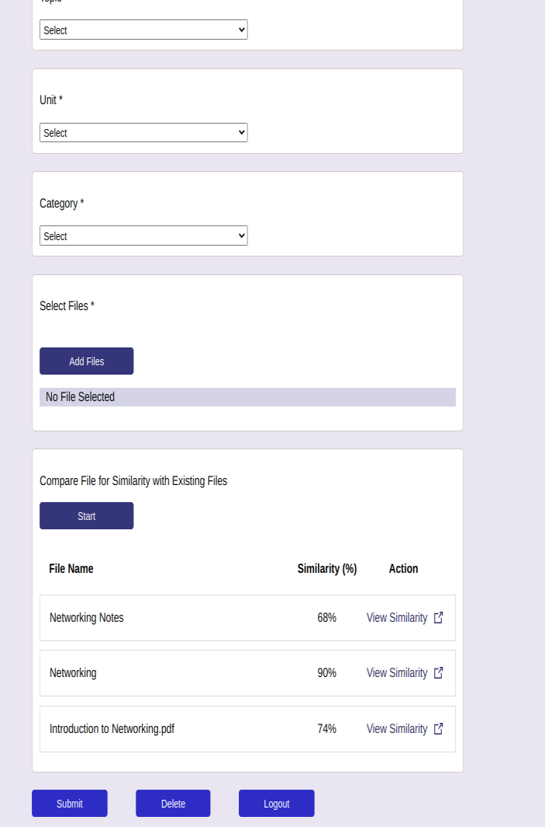
After the admin added the files, the similarity will be compared automatically that the files have any similarity in the form of the percentage with each other documents.

Slide 10
Result & Conclusion
While developing this system COLLEGE NOTES GALLERY, we have learn a lot about the working of system. During the development process, it is very beneficial to all the students for their notes taking in the digital format also it saves time for booth the teachers and the students. We have applied all of the knowledge that we was taught, and each of them contributes to the completion of my project. It's been an immense pleasure, honor, and challenge to have this opportunity and see it through. It has been a pleasure to work with this. While working on the "College Notes Gallery," We learned a lot about how the system works.

Slide 11
References
Web Resources-
1. Reference books HTML and CSS by Jon Duckett. PHP and MySql web
development by Luke Welling, Laura.
2. For string matching algorithm -
https://github.com/google/diff-match-patch
3. Reference for pdf reader https://github.com/mozilla/pdf.js/
4. https://neil.fraser.name/writing/diff/myers.pdf

Slide 12
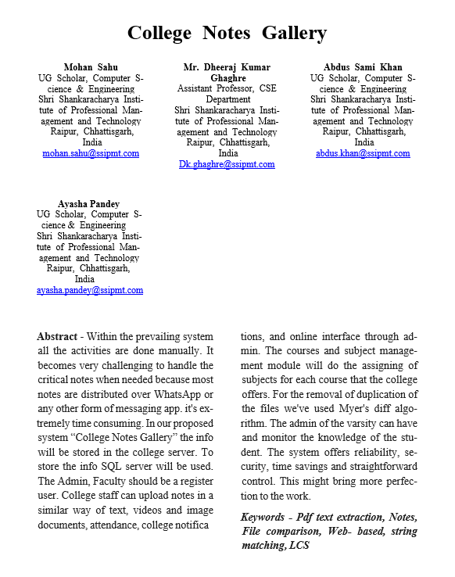
Paper Publication Details

